Slide 1
ACF 302 – Revision Session Part II (weeks 4 to 10)

Slide 2
Outline
Term test outcomes
Setting expectations about final exam
FAQs and Outline of important topics

Slide 3
Term test results:
Average score/100 was 54.
Remember that the test score will be 25% of your final mark.
Assume summer exam score is 70 and a term test of 54, then you’r final mark will = 0.75 x 70 + 0.25 x 54 = 66
Students underperformed in questions 1 to 7. This means you need to pay more attention to content of weeks 1 to 3! This material will be included in the final!
In general, numerical MCQs questions were more prone to error.
In the final you will still have 10 MCQs that will cover topics from week 11 to week 20!

Slide 4
The Final exam (June 4th 9AM)
Final exam will be longer and more difficult than term test.
Take your time to read it carefully and choose the questions to answer.
Final exam has been prepared considering it will be an in-person closed book exam.
There will be an equal amount of analytical/numerical questions and open ended/essay type questions. Prepare for both challenges.

Slide 5
The Final exam structure
2 hours plus 15 min reading
Section A: Questions 1 to 10. Answer ALL questions in this section. (3 marks for each question, total 30 marks for the section)
Section B: answer all questions in this section (total 35 marks)
Section C: Answer only one question (total 35 marks)
2022-2023 same structure. Available online on Moodle.

Slide 6
The Final exam
All Accounting and Finance undergraduate examinations will be in person examinations. Check your timetable to make sure you are aware of the venue of the exam.
(4/06 George Fox LT2 and LT5)
A list of important formulae is included at the end of the examination paper.
The use of standard calculators with scientific, and standard arithmetic and statistical functions, is permitted.

Slide 7
The Final exam - Resit
Date not announced yet.
Resits are expected to take place around weeks 12th to 23rd August.
Resits are in-person! Plan summer (jobs/travel/holidays) accordingly.

Slide 8
General Advice
Read carefully the Department exam guidelines on Moodle.
Manage your time carefully on the day of the exam.
STUDY THE LECTURE material (do not rely on workshops only.
Prepare for the hardest exercise of each workshop.
Help the marker to help you! Make sure that your answer is clear and all the calculations can be followed and understood. This will help the marker to help you giving you partial marks of attempting things.
Remember to highlight your final answer. The absence of a clear answer can result losing marks.

Slide 9
Revision by topic: You should feel confident with the following topics from each chapter:
Equity and Debt financing.
Leasing:
Definition of leasing.
Classification of lease contracts.
True tax lease vs. non tax lease.
Decision of leasing vs. buying.
Working Capital management and short term financing:
Working capital management
Understand the difference between short term and long term financial needs.
Use and combine alternative short term financial instruments.
Sources of short term financial needs
Mergers and Acquisitions:
Reasons to acquire
Valuation and takeovers
LBOs
Corporate Governance and anti takeover defences (week 20 material – INCLUDED IN FINAL)
Corporate Governance and Agency costs
Good handling of jargon and definitions used in corporate governance (Board of directors, type of directors, shareholder activism, entrenchment, what makes a good board, etc.)
Executive compensation: composition, how it is set, manipulation of pay

Slide 10
FAQs
Equity and Debt Financing
Make sure you manage all the definitions of types of funding for different stages of the firm.
All the characteristics of debt and equity that a firm can issue. Convertible preferred stock, convertible bonds, bond covenants, etc.
Exercise on Pre-money valuation and post money valuation.

Slide 11
FAQs
Leasing (buying vs. borrowing):
If no specific method is required, you can use either the direct method (NPV of incremental free cash flows). Here what is most important is that you make clear how you are making the calculations.
Make sure you have a good command of workshop exercises where you need to construct the cash flows.

Slide 12
FAQs
Short term financing
When comparing financing alternatives, if there is a specific financial need and illimited lending capacity from the lender, then you have to adjust the amount borrowed.
If you have a specific financial need and the lenders specify specific lending amounts, then you’ll have to combine sources of financing.
If there’s no specific financial need or borrowing capacity stated, we just compare the EAR from all the options and choose the cheapest.
A no interest compensatory balance requirement means that the amount of money you are required to keep safe in a savings account will not be remunerated. You will have to put let’s say 10% of the borrowed funds on the side for 90 days. At the end of those 90 days, you will recover from that savings account the same money you have deposited. You RECEIVE no interests for this “forced” saving you must make. However, you PAY interests on the full amount borrowed.

Slide 13
FAQs
M&A
Make sure you have a good command of all the workshop exercises.
Valuation exercises that require P/E and EPS ratios.
Revise definitions of alternative take-over defences.
LBO exercise

Slide 14
FAQs
Corporate Governance
The additional reading material is not required for the final, but you should study the lecture slides related to those topics because they will help you understand the concepts learnt in the Corporate Governance Lecture (and these WILL be assessed in the final).
Definition of Board of Directors and types of directors.
Executive compensation design.

Slide 15
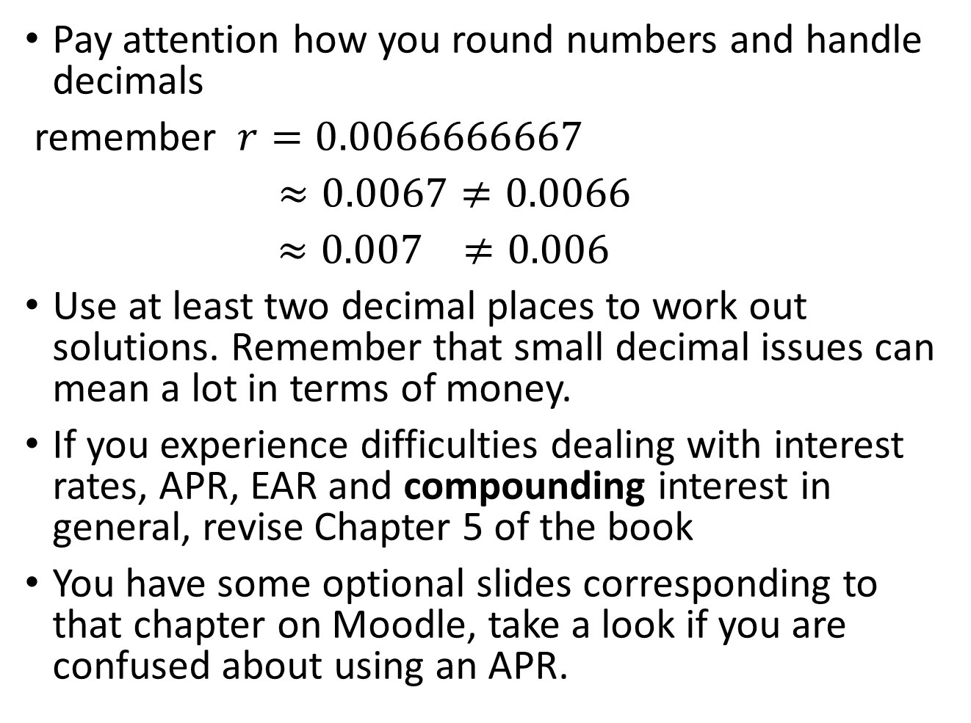
Pay attention how you round numbers and handle decimals
remember $r=0.0066666667$
$≈0.0067≠0.0066$
$≈0.007$ $≠0.006$
Use at least two decimal places to work out solutions. Remember that small decimal issues can mean a lot in terms of money.
If you experience difficulties dealing with interest rates, APR, EAR and compounding interest in general, revise Chapter 5 of the book
You have some optional slides corresponding to that chapter on Moodle, take a look if you are confused about using an APR.

Slide 16
Consultation availability during summer term
You can send me an email or contact me on Teams.
You can send the question straight away or we can arrange a meeting.
Note that I will be VERY slow answering students, so you should contact me with a lot of time in advance of the exam.
I’m very unlikely to answer questions sent less than 72hs before the exam.

Slide 17
Good Luck and Best wishes!!

